Slide 1

Master Thesis Proposal
Presented by: Shamsudeen
Supervised by: Sangeetha Shankar
Date: 21.10.2024

Slide 2
Tracking Personal Transport Emissions: Leveraging Google Timeline Data for Carbon Footprint Visualization and Behavioral Insights
Notes:
title of my thesis is Tracking Personal Transport Emissions: Leveraging Google Timeline Data for Carbon Footprint Visualization and Behavioral Insights.
This title may change as I receive feedback and suggestions, but the core focus remains on visualizing carbon footprints and gain behavioral insights, helping individuals understand how their travel habits contribute to their overall carbon footprint.

Slide 3
Introduction:
Personal transportation is a major contributor to global CO2 emissions
Google Timeline data to analyze and visualize personal transport emissions
By comparing personal emissions with country averages and analyzing trends by transport mode
Notes:
Climate change mitigation requires actionable insights into individual carbon footprints, particularly in the transport sector.
1. but tracking and understanding individual impact remains challenging.
2. This thesis utilizes __________________ providing users with an intuitive view of their carbon footprints.
3. __________ , the project aims to foster greater awareness.

Slide 4
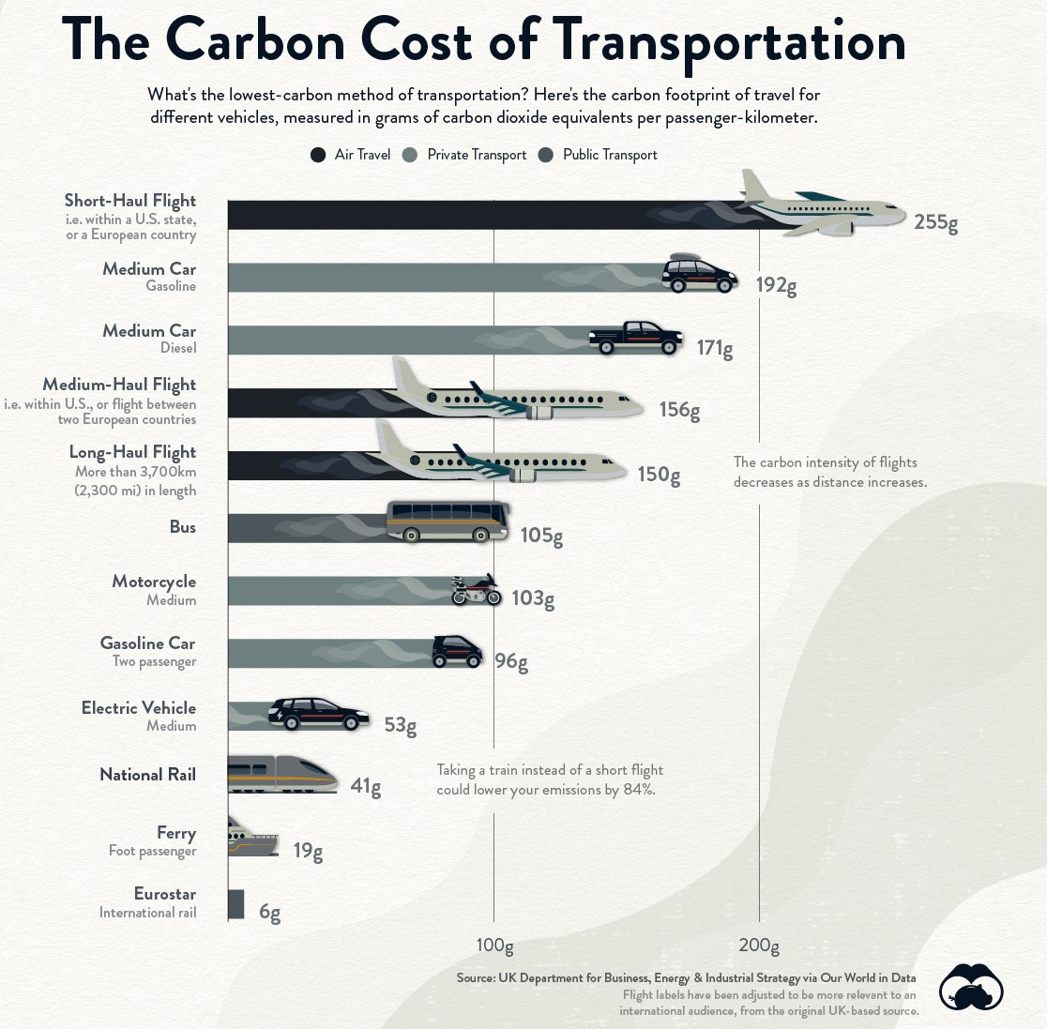
Comparing Carbon Footprint of Transportation Options
Notes:
As concern about climate change has grown, individuals are becoming increasingly conscious of their impact on the environment.
Transportation emissions often make up the largest portion of our individual carbon footprints. For that reason, evaluating transport options is a natural place to start, whether it is for a daily commute or a leisure trip abroad.
So, what’s the most eco-friendly way to go from one place to another?
The infographic charts the carbon footprint of transportation per passenger-kilometer for different vehicles based on data from the UK Government’s methodology paper for greenhouse gas reporting.

Slide 5

Research Questions
How accurately can personal carbon emissions be estimated using geolocation data from Google Timeline, compared to manual records and established emission models?
Notes:
My main research question is: How accurately can we estimate personal carbon emissions using geolocation data from Google Timeline? I’ll be comparing these estimates to manual records and established emission models to see how reliable and precise Google Timeline data is for tracking personal transport emissions.

Slide 6

Objectives
Analyze personal transport emissions using Google Timeline data and quantify individual carbon footprints.
Identify patterns and trends in emissions based on transport modes, frequency, and distance travelled.
Explore correlations between transport choices
Assess the potential of using geospatial tools like Google Timeline
Notes:
3. and emissions to identify opportunities for reduction.
4. to raise awareness and encourage behavior change in reducing transport-related carbon footprints.

Slide 7
Literature Review
Geolocation tools such as Google Timeline can effectively estimate carbon emissions by tracking individual travel behavior, though accuracy can be influenced by variations in travel modes and data resolution. These tools help identify transport modes contributing the most to emission (1).
Studies highlight substantial differences in emissions across transport modes, with cars contributing significantly more than public transport, cycling, or walking. Replacing car trips with active transport options could drastically reduce emissions (1,2).
Research comparing automated data extraction methods from geolocation tools versus manual surveys suggests that tools like Google Timeline provide reliable estimates for personal transport emissions. However, calibration against established emission models enhances accuracy (3).
Research shows that personal transport emission tracking can increase user awareness of their carbon footprint, prompting behavior change. This awareness, facilitated by visualization tools, encourages users to adopt more sustainable travel options, such as cycling or public transport (4).
Several studies analyze how individual emissions relate to national and global averages. By comparing personal emissions with country-level data, individuals can contextualize their environmental impact, which can reinforce sustainable decision-making (1,5).

Slide 8
Literature Review
6. Active transport modes like walking and cycling not only reduce carbon emissions but also provide health benefits, as emphasized in numerous studies. Encouraging these modes can support both environmental and public health goals (6,7).
7. Studies on the long-term tracking of personal transport emissions reveal trends in travel patterns and shifts toward sustainable transport over time. These trends help assess the effectiveness of interventions like emission tracking tools (2,4).
8. Several papers underscore the potential of transport emission tracking tools to contribute to broader climate action. When combined with policy interventions, personal carbon tracking can play a role in reducing overall greenhouse gas emissions (8).
9. Research on regional and national transport policies shows that integrating carbon footprint awareness into personal and public transport systems can enhance efforts to meet emission reduction targets (9).
10. Despite the potential of tools like Google Timeline, challenges remain, including data privacy concerns and ensuring that users consistently engage with these tools to generate meaningful emissions data (10).

Slide 9

Methodology
Data Collection
Source: Google Timeline (Travel history, geolocation data)
Extraction: Automated extraction of travel data (mode, distance, time)
Categorization: Segment by transport modes (car, public transit, walking, cycling)

Slide 10
Methodology
Emission Calculation
Emission Models: Apply transport-specific emission factors (e.g., CO2 per km for each mode).
Data Processing: Convert travel data into carbon emissions using standard emission factors.
User Emission Profile
Analysis: Compute total emissions per user, per mode of transport.
Comparison: Compare individual emissions with national or global averages.

Slide 11
Methodology
Statistical Analysis
Trend Analysis: Analyze yearly or monthly emission trends.
Correlation & Regression: Investigate correlations between transport choices and emission levels.
Visualization
Emission Maps: Visualize travel routes with emission heatmaps
Comparative Charts: Display emission comparisons across transport modes and timeframes

Slide 12
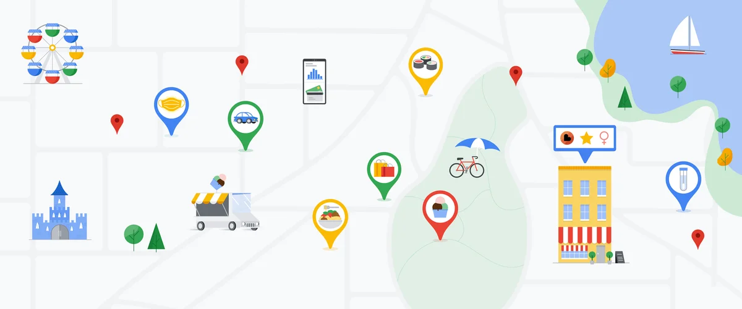
Outcome
Estimate personal carbon emissions.
Grams of CO2 equivalent produced for various journeys.
Using this tool, we can create visualizations of one's transport history, highlighting the significant impact of different transportation modes on total emissions.
Notes:
The goal of this thesis is to ___________________ generated through transportation by analyzing Google Maps Timeline data.
By applying emission factors to each mode of transport, The system calculates the
This application offers individuals a tailored insight into their transport-related carbon footprint, empowering them to make informed, eco-conscious decisions.
For example, air travel typically accounts for the highest emissions, followed by car usage, while public transportation and cycling have a much lower carbon footprint.

Slide 13
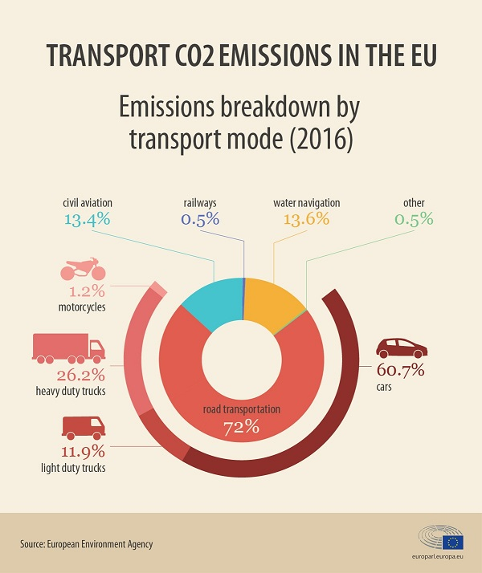
Expected Result
Personal Emission Profiles:
Users will receive detailed profiles of their carbon emissions based on their travel habits.
Comparative Insights:
The platform will enable users to compare their emissions against national and global averages.
Notes:
The tool will calculate total emissions for different transport modes, allowing users to see which modes contribute most to their carbon footprint.
This personalized feedback is expected to enhance users' awareness of their travel choices and their environmental impact, in line with findings that suggest personal tracking tools can influence behavior change positively.
This comparison is expected to motivate users to adopt more sustainable transport options by highlighting the disparities between their travel habits and broader trends.

Slide 14

Expected Result
Trend Analysis:
Yearly or monthly trends in individual and collective emissions.
How travel patterns evolve over time.
Enhanced User Engagement:
Emission heatmaps and comparative charts
Notes:
The project aims to uncover
This trend analysis will provide insights into _____________ and whether users are moving towards more sustainable practices.
Previous studies suggest that regular feedback and data visualization can encourage users to make long-term changes in their transportation choices.
Enhanced User Engagement:
By offering visualizations such as ______, the tool is expected to increase user engagement.
Interactive features and personalized recommendations based on travel behavior are anticipated to further motivate users to adopt low-emission transport modes.
Overall, the project aims to demonstrate the potential of geospatial tools in promoting climate awareness and action.
By empowering individuals to track and reduce their carbon footprints, the application can contribute to broader efforts in mitigating climate change.
Studies indicate that leveraging technology for personal emission tracking can lead to meaningful reductions in greenhouse gas emissions at both individual and collective levels.

Slide 15
Contribution
Geospatial Tools: Leverage Google Timeline for personal carbon tracking.
Policy Implications: Compare individual emissions with national averages.
Practical Application: Develop a user-friendly tool.
Academic Impact: Contribute to research on transport emissions and sustainability.
Notes:
Geospatial Tools: "In this project, I leverage Google Timeline, a geospatial tool that tracks an individual’s location history, to quantify personal transport emissions. This innovative use of geospatial data allows us to visualize carbon footprints based, giving users a clearer understanding of how their daily transport choices contribute to overall emissions."
Policy Implications: "By comparing individual emissions with national and global averages, this project not only helps users contextualize their own impact but also offers broader insights into transportation emissions trends. These insights can be valuable for policymakers looking to develop targeted interventions that encourage sustainable transport choices."
Practical Application: This tool will offer visualizations like emission heatmaps and charts, making it easy for users to understand their travel-related emissions and identify areas for improvement. This practical implementation ensures that the research is accessible and actionable for the public."
Academic Impact: "Lastly, this project contributes to the academic discourse on transport emissions and sustainability. By exploring the effectiveness of personal tracking tools in reducing emissions, it fills a gap in current research and adds to our understanding of how technology can drive climate action on an individual level."

Slide 16
Conclusion
Potential of using geospatial tools like Google Timeline for environmental analysis.
With further refinement and application, such tools can contribute to broader climate action by empowering individuals to understand and mitigate their carbon footprints.
Notes:
The thesis illustrates the
According to the Global Carbon Project's 2022 estimates, global emissions in 2022 reached 40.6 GtCO2.
"Reaching zero CO2 emissions by 2050 entails a total anthropogenic CO2 emissions linear decrease by about 1.4 GtCO2 each year, comparable to the observed fall in 2020 emissions resulting from COVID-19 measures, highlighting the scale of the action needed. This would result in additional emissions of 560 GtCO 2 from year 2023, leading to a 50% likelihood to limit warming around 1.6°C"

Slide 17
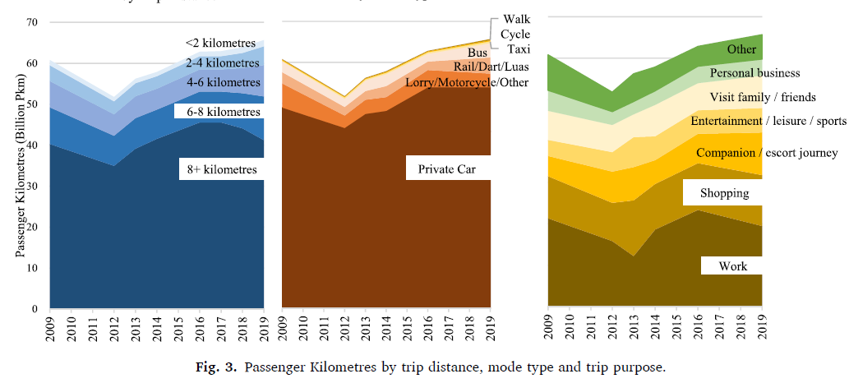
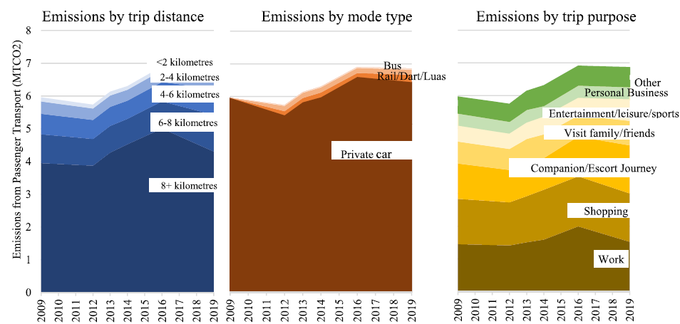
Reference

Slide 18
Reference
O'Riordan, Vera, et al. "How and why we travel–mobility demand and emissions from passenger transport." Transportation Research Part D: Transport and Environment 104 (2022): 103195.
Peng, Bo, et al. "Carbon emission calculation method and low-carbon technology for use in expressway construction." Sustainability 12.8 (2020): 3219.
Zhang, Nan, et al. "Towards low-carbon cities through building-stock-level carbon emission analysis: A calculating and mapping method." Sustainable cities and society 78 (2022): 103633.
Naiudomthum, Supiya, Ekbordin Winijkul, and Sunicha Sirisubtawee. "Near real-time spatial and temporal distribution of traffic emissions in Bangkok using Google Maps application program interface." Atmosphere 13.11 (2022): 1803.
Rito, Joshua Ezekiel, Neil Stephen Lopez, and Jose Bienvenido Manuel Biona. "Modeling traffic flow, energy use, and emissions using google maps and google street view: The case of Edsa, Philippines." Sustainability 13.12 (2021): 6682.
Long, Zhi, et al. "Spatially explicit carbon emissions at the county scale." Resources, Conservation and Recycling 173 (2021): 105706.
Rito, J. E., and N. S. Lopez. "Transport Emissions Modeling using Google Maps: An alternative approach for vehicle flow analysis." IOP Conference Series: Materials Science and Engineering. Vol. 1109. No. 1. IOP Publishing, 2021.
Rito, Joshua Ezekiel, Neil Stephen Lopez, and Jose Bienvenido Manuel Biona. "Modeling traffic flow, energy use, and emissions using google maps and google street view: The case of Edsa, Philippines." Sustainability 13.12 (2021): 6682.
Zhang, Jinlei, et al. "Spatiotemporal patterns of carbon emissions and taxi travel using GPS data in Beijing." Energies 11.3 (2018): 500.
Wyatt, David W., Hu Li, and James E. Tate. "The impact of road grade on carbon dioxide (CO2) emission of a passenger vehicle in real-world driving." Transportation Research Part D: Transport and Environment 32 (2014): 160-170.

Slide 19
Synopsis
Google Timeline data
Personalized carbon footprint
Identify emission trends.
Heatmaps, comparative charts.
Promote sustainable transport choices and climate action.
Notes:
1. This thesis explores the use of Google Timeline data to track and visualize personal transport emissions.
2. By leveraging geolocation data, the project aims to provide users with personalized carbon footprint insights based on their travel patterns.
3. The expected outcomes include detailed emission profiles, trend analyses,
4. and personalized feedback through data visualization tools such as emission heatmaps and comparative charts.
In summary, this research highlights the potential of integrating personal emission tracking tools into climate mitigation strategies, promoting greater awareness, and fostering sustainable transport choices.

